Slide 1
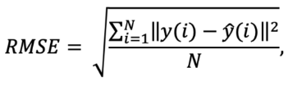
Root Mean Square Error (RMSE)
Root mean square error shows how far predictions fall from measured true values using Euclidean distance.
To compute RMSE, calculate the residual (difference between prediction and truth) for each data point, compute the norm of residual for each data point, compute the mean of residuals and take the square root of that mean.
RMSE is commonly used in supervised learning applications, as RMSE uses and needs true measurements at each predicted data point.

Slide 2
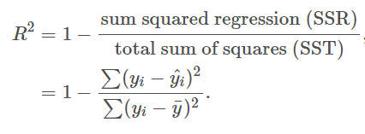
R² Error or the coefficient of determination
R² is a statistical measure of how well the regression line approximates the actual data
It is a scale-free score i.e. irrespective of the values being small or large, the value of R square will be less than one.
Residual : difference between predicted values of y (dependent variable) and observed values of y.
The sum squared regression is the sum of the residuals squared
The total sum of squares is the sum of the distance the data is away from the mean all squared.
R² will take values between 0 and 1.

Slide 3
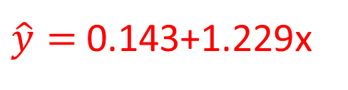
Example
You wish to perform a regression analysis on how the number lectures per day (x) affects the number of hours spent (y) at university per day
Assume you have built the following hypothesis for regression model
Calculate R².
x | y
2 | 2
3 | 4
4 | 6
6 | 7
$\hat{y}=$0.143+1.229x

Slide 4
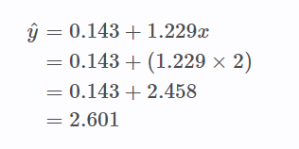

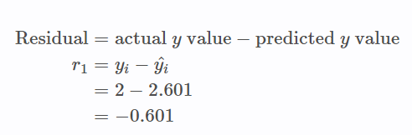
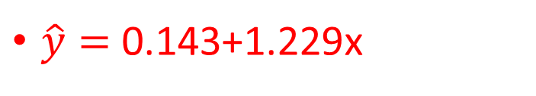
To calculate R² you need to find the sum of the residuals squared and the total sum of squares.
$\hat{y}=$0.143+1.229x
The actual value for y is 2.

Slide 5
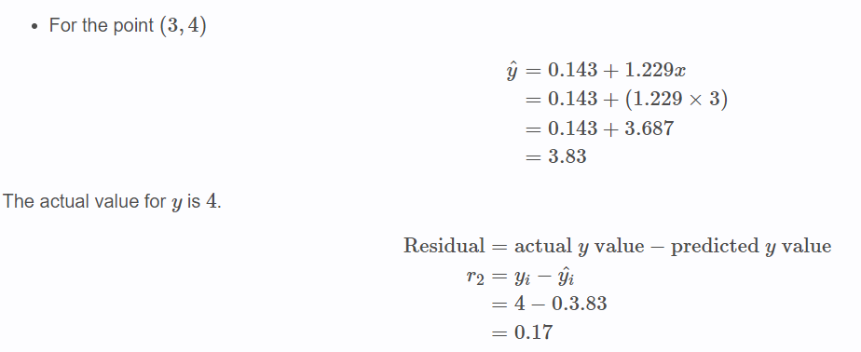

Slide 6
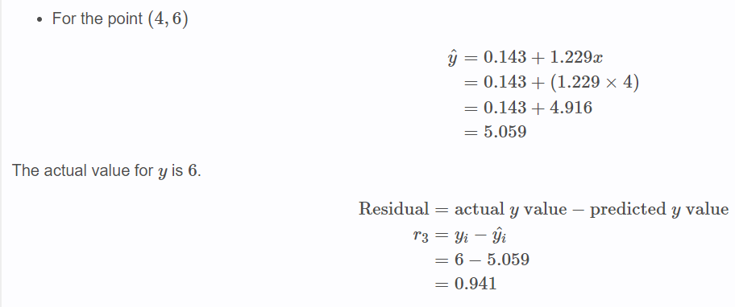

Slide 7
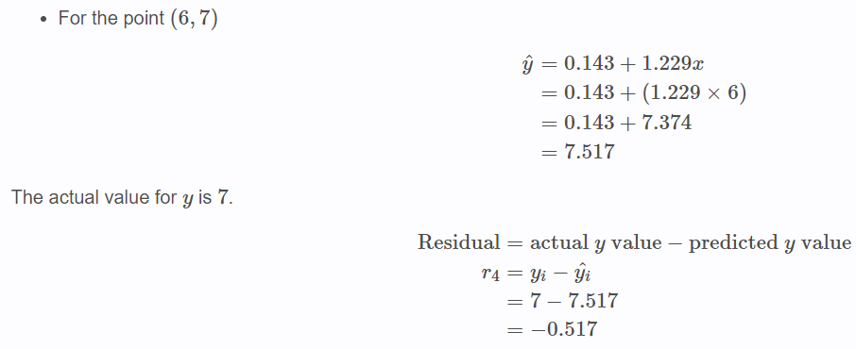

Slide 8
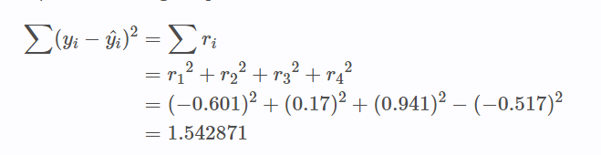
To find the residuals squared we need to square each of r1to r4 and sum them.

Slide 9

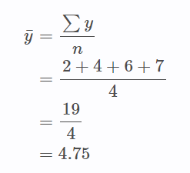
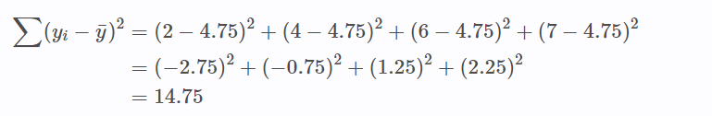
Total sum of squares

Slide 10
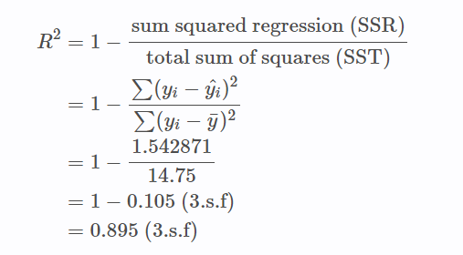
This means that the number of lectures per day account for 89.5% of the variation in the hours people spend at university per day.

Slide 11
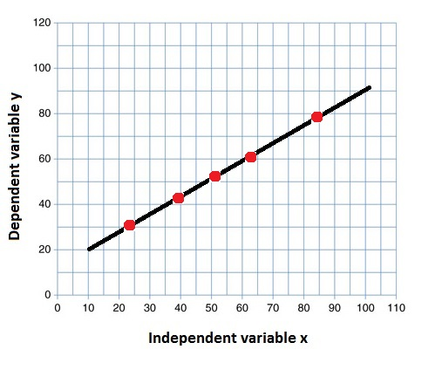
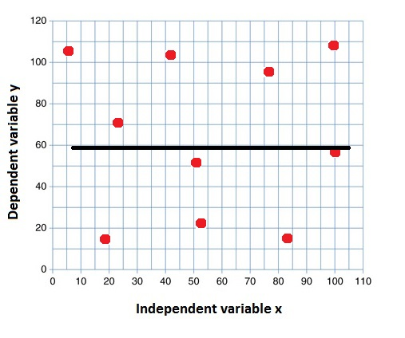
Interpretation of the R² value
R² = 1
R² = 0

